Slide 1



FPT Software
ANDROID TRAINING
LESSON 6
Version 0.1

Slide 2
Agenda
Android Intents
Using Intents to call Activities
Defining Intent Filters
Intents as event triggers
Share Intent and ShareActionProvider
Finding out if an Intent is available

Slide 3
Intents
Intents are asynchronous messages which allow Android components to request functionality from other components of the Android system.
For example an Activity can send an Intents to the Android system which starts another Activity.

Slide 4
Intents
Intent Object Structure Is Made Of
  Component name
  Action
  Data
  Category
  Extras
  Flags

Slide 5
Intents
Component name Field
  Specifies the name of the component (name of the activity if the component is activity) that should handle the intent
    >Class name of the target component (for example "com.javapassion.ForwardTargetActivity")
  Setting component name is optional
    If it is set, the Intent object is delivered to an instance of the designated class.
    If it is not set, Android uses other information in the Intent object to locate a suitable target

Slide 6
Intents
Action Field
  A string naming the action to be performed
  The Intent class defines a number of pre-defined action constants, including
    ACTION_CALL, ACTION_EDIT, ACTION_MAIN, ACTION_SYNC, ACTION_BATTERY_LOW, etc.
  You can also define your own action strings for activating the components in your application
  The action largely determines how the rest of the intent is structured - particularly the data and extras fields - much as a method name determines a set of arguments and a return value.

Slide 7
Intents
Data Field
  The URI of the data to be acted on and the MIME type of that data.
  Different actions are paired with different kinds of data specifications.
    If the action field is ACTION_EDIT, the data field would contain the URI of the document to be displayed for editing.
    If the action is ACTION_CALL, the data field would be a tel: URI with the number to call.
    If the action is ACTION_VIEW and the data field is an http: URI, the receiving activity would be called upon to download and display whatever data the URI refers to.

Slide 8
Intents
Category Field
  A string containing additional information about the kind of component (activity, service, or broadcast receiver) that should handle the intent.
  Any number of category descriptions can be placed in an Intent object
  Android provides a set of predefined categories (We will see them in the following slide)
  You can define your own categories

Slide 9
Intents
CATEGORY_BROWSABLE - The target activity can be invoked within the browser to display data referenced by a link — for example, an image or an e-mail message.
CATEGORY_GADGET - The activity can be embedded inside of another activity that hosts gadgets
CATEGORY_HOME - This is the home activity, that is the first activity that is displayed when the device boots.
CATEGORY_LAUNCHER - The activity can be the initial activity of a task and is listed in the top-level application launcher.
CATEGORY_PREFERENCE - The target activity is a preference panel.
Many more

Slide 10
Intents
Extras Field
  Key-value pairs for additional information that should be delivered to the component handling the intent.
  Just as some actions are paired with particular kinds of data URIs, some are paired with particular extras.
    ACTION_TIMEZONE_CHANGED action has a "time-zone" extra that identifies the new time zone
    ACTION_HEADSET_PLUG action has a "state" extra indicating whether the headset is now plugged in or unplugged , as well as a "name" extra for the type of headset
    If you were to invent a SHOW_COLOR action, the color value would be set in an extra key-value pair.

Slide 11
Intents
Flags Field
  Flags of various sorts.
  Many instruct the Android system how to launch an activity (for example, which task the activity should belong to) and how to treat it after it's launched (for example, whether it belongs in the list of recent activities).

Slide 12
Intents
Types of Intents
  Explicit intents
  Implicit intents

Slide 13
Explicit Intents
Explicit Intents explicitly names the component which should be called by the Android system, by using the Java class as identifier.
  Intent i = new Intent(this, ActivityTwo.class);
  i.putExtra("Value1", "This value one for ActivityTwo ");
  i.putExtra("Value2", "This value two ActivityTwo");
Explicit Intents are typically used within on application as the classes in an application are controlled by the application developer.

Slide 14
Implicit Intents
Implicit Intents do not specify the Java class which should be called. They specify the action which should be performed and optionally an URI which should be used for this action.
  Intent intent = new Intent(Intent.ACTION_VIEW, Uri.parse("http://www.google.com"));

Slide 15
Data Transfer
An implicit Intent contains the Action and optional the URI. The receiving component can get this information via the getAction() and getData() methods.
Explicit and implicit Intents can also contain additional data. This data call be filled by the component which creates the Intent. It can and can get extracted by the component which receives the Intent.

Slide 16
Data Transfer
Creates the Intent can add data to it via the overloaded putExtra() method
For example you can trigger all components which have been registered to send some data via the new Intent(Intent.ACTION_SEND). This Intent determines possible receivers via the type. What is send it defined via the putExtra method. You can use any String as key, the following uses the keys which are predefined for the ACTION_SEND intent.

Slide 17
Data Transfer
Intent sharingIntent = new Intent(Intent.ACTION_SEND);
sharingIntent.setType("text/plain");
sharingIntent.putExtra(android.content.Intent.EXTRA_TEXT, "News for you!");
// createChooser is a convenience method to create
// an Chooser Intent with a Title
startActivity(Intent.createChooser(sharingIntent,"Share this using"));

Slide 18
Data Transfer
The component which receives the Intent can use the getIntent().getExtras() method call to get the extra data.
  Bundle extras = getIntent().getExtras();
  if (extras == null) { return; }
  // Get data via the key
  String value1 = extras.getString(Intent.EXTRA_TEXT);
  if (value1 != null) {
  // Do something with the data
  }

Slide 19
Calling Activities
To start an Activity use the method startActivity(Intent). This method is defined on the Context object and available in every Activity object.

Slide 20
Calling Sub-Activities for result data
If you need some information from the called Activity use the startActivityForResult() method.
  public void onClick(View view) {
    Intent i = new Intent(this, ActivityTwo.class);
    i.putExtra("Value1", "This value one for ActivityTwo ");
    i.putExtra("Value2", "This value two ActivityTwo");
    // Set the request code to any code you like, you can identify the
    // callback via this code
    startActivityForResult(i, REQUEST_CODE);
  }

Slide 21
Calling Sub-Activities for result data
If you use the startActivityForResult() method then the started Activity is called a Sub-Activity.
If the Sub-Activity is finished it can send data back to its caller via Intent. This is done in the finish() method.

Slide 22
Calling Sub-Activities for result data
@Override
public void finish() {
  // Prepare data intent
  Intent data = new Intent();
  data.putExtra("returnKey1", "Swinging on a star. ");
  data.putExtra("returnKey2", "You could be better then you are. ");
  // Activity finished ok, return the data
  setResult(RESULT_OK, data);
  super.finish();
}

Slide 23
Calling Sub-Activities for result data
Once the Sub-Activity finished, the onActivityResult() method in the calling Activity will be called.
@Override
protected void onActivityResult(int requestCode, int resultCode, Intent data)
{
  if (resultCode == RESULT_OK && requestCode == REQUEST_CODE)
  {
    if (data.hasExtra("returnKey1"))
    {
      Toast.makeText(this, data.getExtras().getString("returnKey1"), Toast.LENGTH_SHORT).show();
    }
  }
}

Slide 24
Intent Filters
What are Intent Filters?
  Filters informs the system which implicit intents a component can handle
  If a component does not have any intent filters, it can receive only explicit intents.
  A component with filters can receive both explicit and implicit intents.
  A component has separate filters for each job it can do

Slide 25
Intent Filters
IntentFilters are typically defined via the AndroidManifest.xml file. For BroadcastReceiver it is also possible to define them in coding. An IntentFilters is defined by its category, action and data filters. It can also contain additional metadata.

Slide 26
Intent Filters
An implicit Intent object are tested against an intent filters (of target components) in three areas
  Action
  Category
  Data (both URI and data type)
To be delivered to the target component that owns the filter, it must pass all three tests
If an intent can pass through the filters of more than one activity or service, the user may be asked which component to activate.
If no target can be found, an exception is raised

Slide 27
Life Cycle
Each application runs in its own process.
Each activity of an app is run in the apps process
Processes are started and stopped as needed to run an apps components.
Processes may be killed to reclaim needed resources.
Killed apps may be restored to their last state when requested by the user

Slide 28
Activity
Most management of the life cycle is done automatically by the system via the activity stack.
The activity class has the following method callbacks to help you manage the app:
  onCreate()
  onStart()
  onResume()
  onPause()
  onStop()
  onRestart()
  onDestroy()

Slide 29
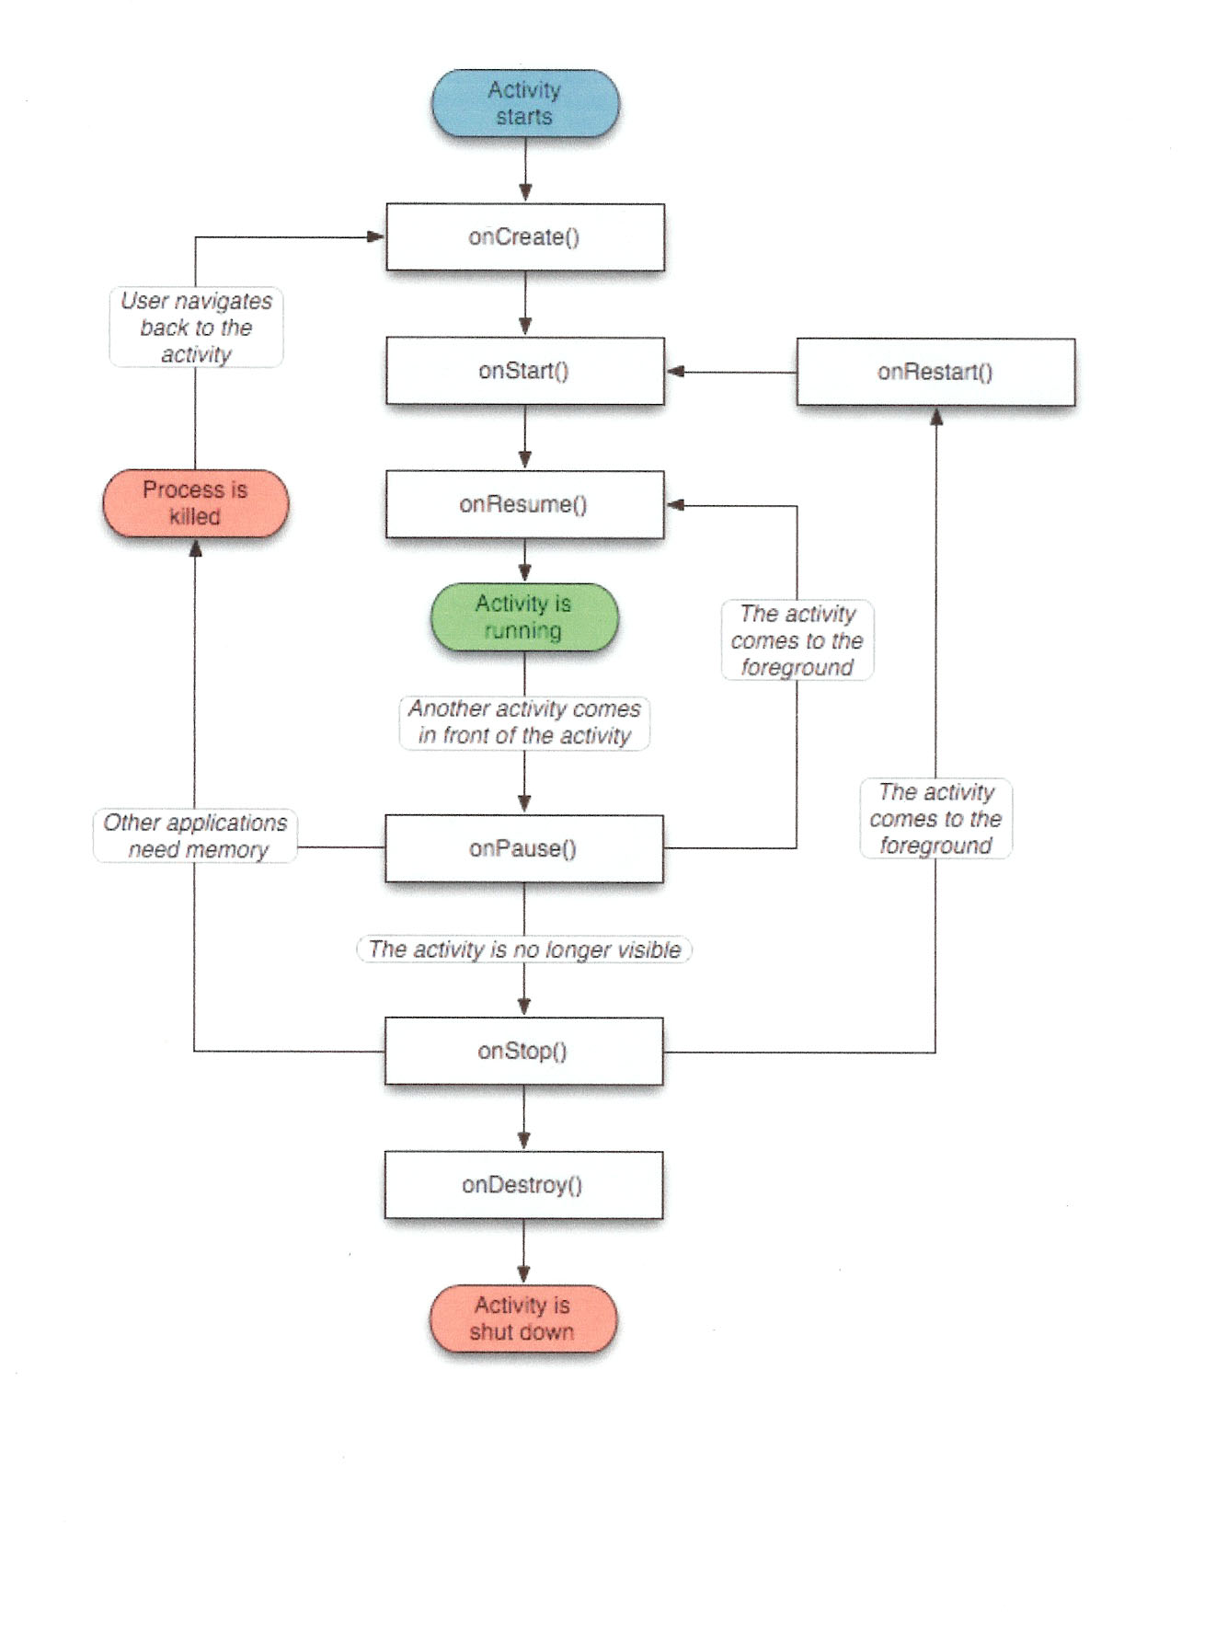

Slide 30
Activity
There are three "phases" of the activity life cycle: Start- Up, Normal Execution and Shutdown.
  In the Start - Up phase, the system calls onCreate(), onStart/ onRestart() , possibly onRestoreInstanceState() , and onResume().
  During the Normal Execution phase, it is common for onSaveInstanceState() and onPause() to be called.
  In the Shutdown phase, onStop() and onDestroy() may be called.

Slide 31
Homework
Create Notification
Click on Notification to start active with extra data

Slide 32
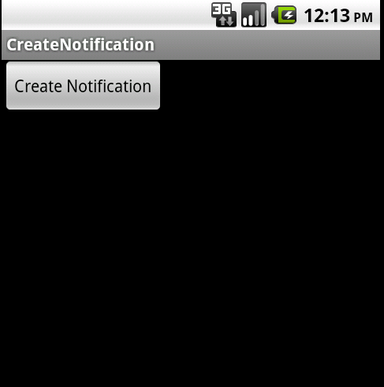
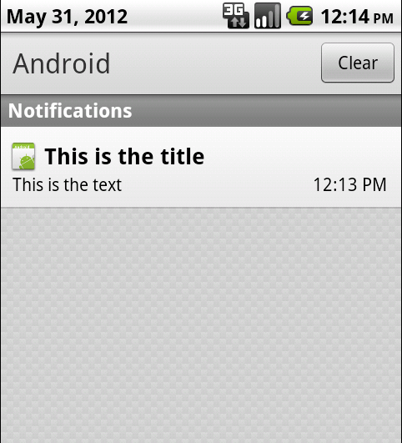
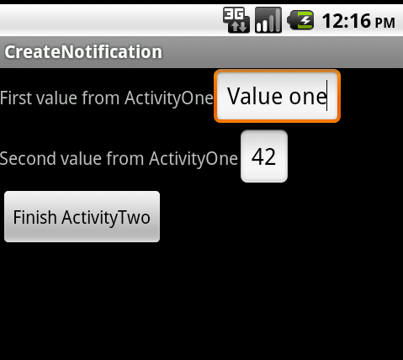
Homework

Slide 33
Thank you!

